Slide 1
Microsoft Azure Fundamentals
Module 2, Section 4
Dr. Tóth Ádám
toth.adam@inf.unideb.hu

Slide 2
Identity, access, and security
Notes:
https://learn.microsoft.com/training/modules/describe-azure-identity-access-security

Slide 3









Compare authentication and authorization
Authentication
Authorization
Identifies the person or service seeking access to a resource.
Requests legitimate access credentials.
Basis for creating secure identity and access control principles.
Determines an authenticated person’s or service’s level of access.
Defines which data they can access, and what they can do with it.
Notes:
https://learn.microsoft.com/training/modules/describe-azure-identity-access-security/3-authentication-methods
Identity has become the new primary security boundary. Accurately proving that someone is a valid user of your system, with an appropriate level of access, is critical to maintaining control of your data. This identity layer is now more often the target of attack than the network is.
✔️Authentication is sometimes shortened to AuthN, and authorization is sometimes shortened to AuthZ.

Slide 4

Microsoft Entra ID
Microsoft Entra ID is Microsoft Azure’s cloud-based identity and access management service.
Authentication (employees sign in to access resources).
Single sign-on (SSO).
Application management.
Business to Business (B2B).
Device management.
Notes:
https://learn.microsoft.com/training/modules/describe-azure-identity-access-security/2-directory-services

Slide 5
Entra ID
Identity management
Device management
Federation and SSO
Resource Access
Conditional access
Identity protection

Slide 6
Entra ID users
IT administrators: Administrators can use Azure AD to control access to applications and resources based on their business requirements.
App developers: Developers can use Azure AD to provide a standards-based approach for adding functionality to applications that they build.
Users: Users can manage their identities.
Online service subscribers: Microsoft 365, Microsoft Office 365, Azure, and Microsoft Dynamics CRM Online subscribers are already using Azure AD.

Slide 7
On-premises AD with Microsoft Entra ID
You can connect Active Directory with Microsoft Entra ID, enabling a consistent identity experience between cloud and on-premises.
Microsoft Entra Connect: Microsoft Entra Connect synchronizes user identities between on-premises Active Directory and Azure AD.
Microsoft Entra Connect synchronizes changes between both identity systems, so you can use features like SSO, multifactor authentication, and self-service password reset under both systems.

Slide 8
Microsoft Entra Domain Services
Microsoft Entra Domain Services is a service that provides managed domain services such as domain join, group policy, lightweight directory access protocol (LDAP), and Kerberos/NTLM authentication.
A Microsoft Entra Domain Services managed domain lets you run legacy applications in the cloud that can't use modern authentication methods, or where you don't want directory lookups to always go back to an on-premises AD DS environment.
Microsoft Entra Domain Services integrates with your existing Microsoft Entra tenant-> users sign into services and applications connected to the managed domain using their existing credentials

Slide 9
Microsoft Entra Domain Services
When you create an Microsoft Entra Domain Services managed domain, you define a unique namespace->domain name
Two Windows Server domain controllers are then deployed into your selected Azure region
The Azure platform handles the DCs as part of the managed domain, including backups and encryption at rest using Azure Disk Encryption.

Slide 10
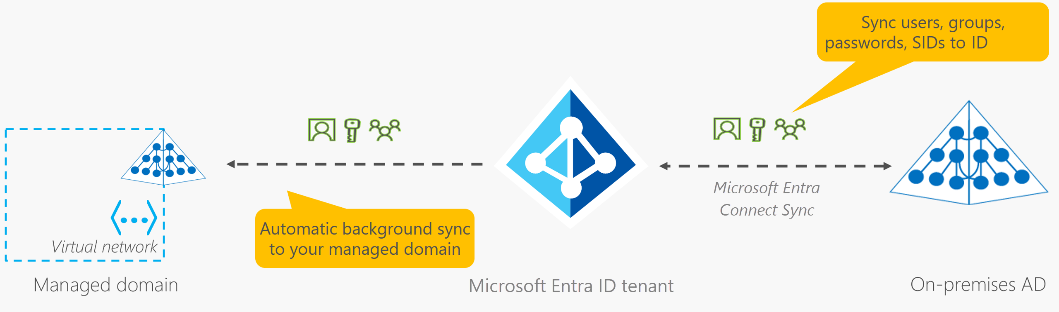
Microsoft Entra Domain Services
Gain the benefit of cloud-based domain services without managing domain controllers.
Run legacy applications (that can’t use modern auth standards) in the cloud.
Automatically sync from Microsoft Entra ID.
Notes:
https://learn.microsoft.com/training/modules/describe-azure-identity-access-security/2-directory-services
Microsoft Entra ID: https://www.microsoft.com/security/business/identity-access/microsoft-entra-id

Slide 11
Single sign-on
Single sign-on enables a user to sign in one time and use that credential to access multiple resources and applications from different providers.
If a user leaves an organization, tracking down all those identities and ensuring they are disabled can be challenging. If an identity is overlooked, this might allow access when it should have been eliminated.

Slide 12
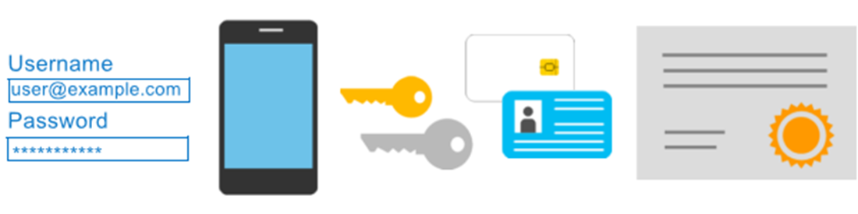
Multifactor authentication
Provides additional security for your identities by requiring two or more elements for full authentication.
Something you know ←→ Something you possess ←→ Something you are
Notes:
https://learn.microsoft.com/training/modules/describe-azure-identity-access-security/3-authentication-methods
Discuss what could qualify for each of the items listed:
Something you know: This could be a password or the answer to a security question.
Something you possess: This might be a mobile app that receives a notification, or a token-generating device.
Something you are: This is typically some sort of biometric property, such as a fingerprint or face scan used on many mobile devices.
MFA: https://learn.microsoft.com/azure/active-directory/authentication/concept-mfa-howitworks

Slide 13
Passwordless authentication
Passwordless authentication methods are more convenient because the password is removed and replaced with something you have, plus something you are, or something you know.
Passwordless authentication needs to be set up on a device before it can work.
Microsoft global Azure and Azure Government offer the following three passwordless authentication options:
Windows Hello for Business
Microsoft Authenticator App
FIDO2 security keys

Slide 14
Azure external identities
An external identity is a person, device, service, etc. that is outside your organization.
Microsoft Entra External Identities refers to all the ways you can securely interact with users outside of your organization.
External identities may sound similar to single sign-on.
The external user’s identity provider manages their identity, and you manage access to your apps with Microsoft Entra ID or Azure AD B2C to keep your resources protected.

Slide 15
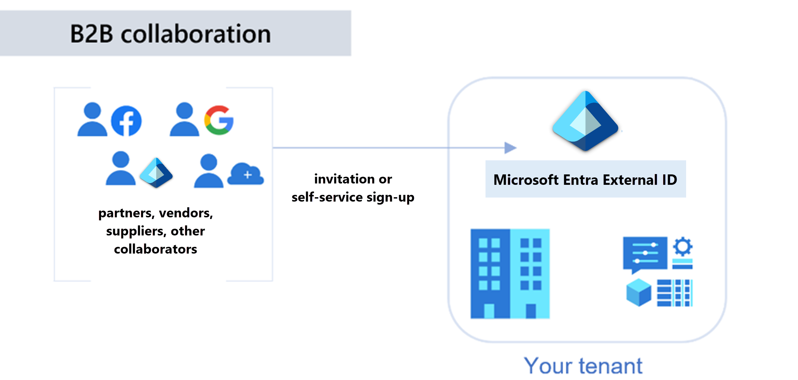
Microsoft Entra External ID B2B
Notes:
https://learn.microsoft.com/training/modules/describe-azure-identity-access-security/4-external-identities

Slide 16
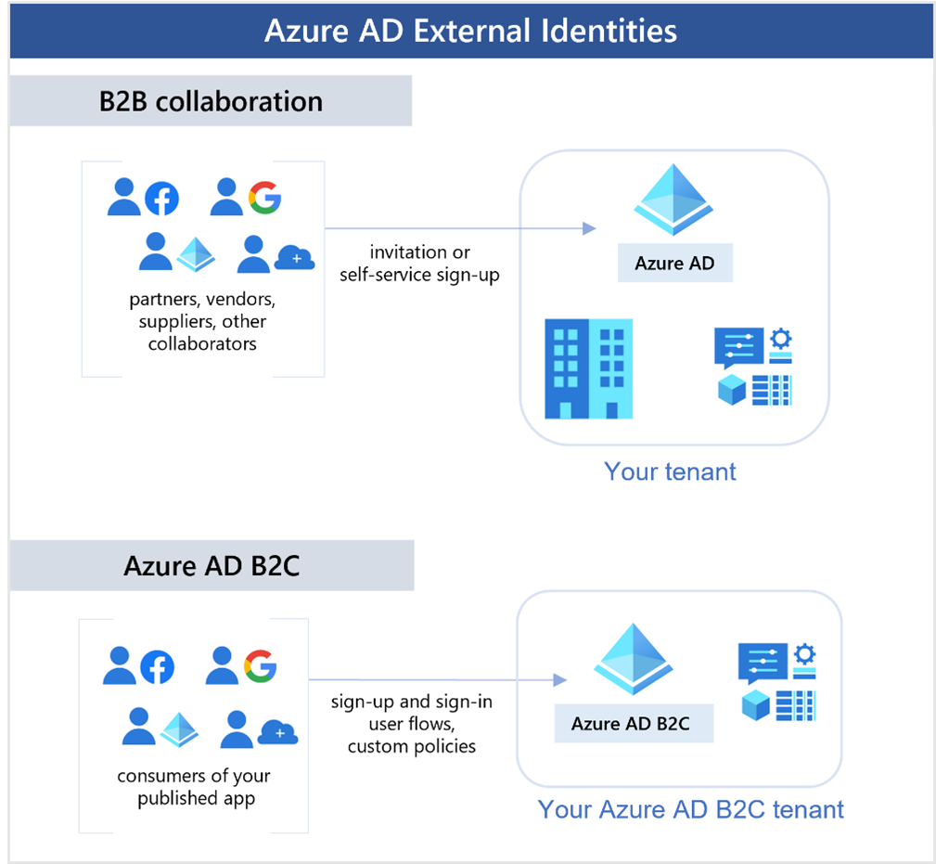
Azure AD External Identities B2C
Notes:
https://learn.microsoft.com/training/modules/describe-azure-identity-access-security/4-external-identities

Slide 17
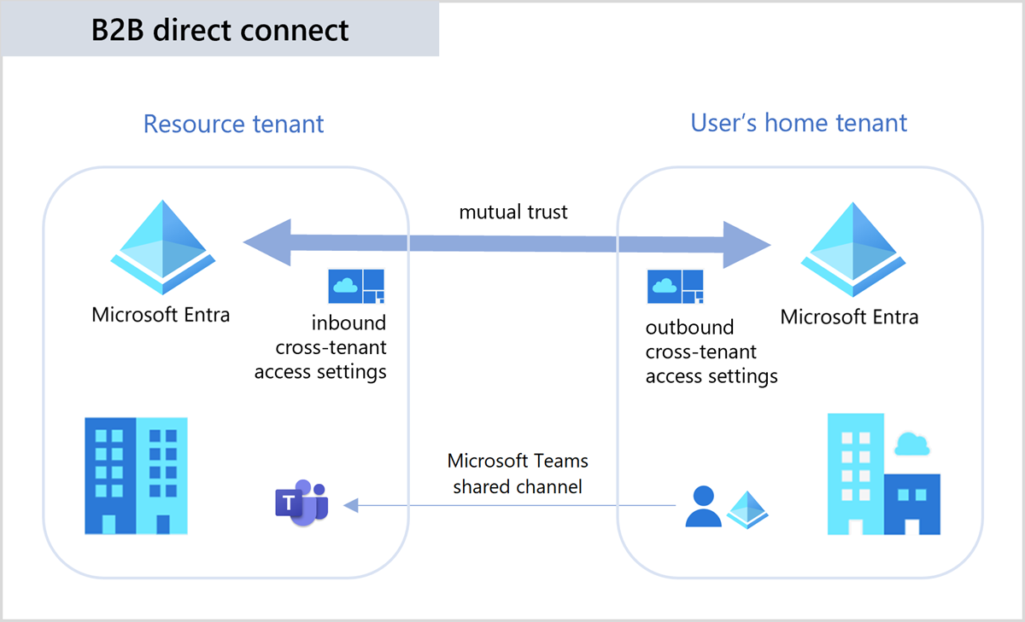
B2B direct connect
Notes:
https://learn.microsoft.com/training/modules/describe-azure-identity-access-security/4-external-identities

Slide 18
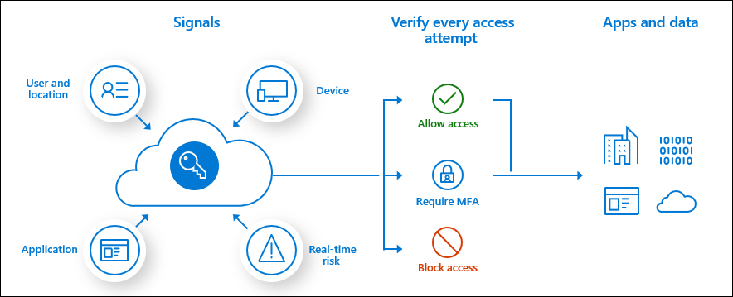
Conditional Access
Conditional Access is used to bring signals together, to make decisions, and enforce organizational policies.
User or group membership
IP location
Device
Application
Risk detection
Notes:
https://learn.microsoft.com/training/modules/describe-azure-identity-access-security/5-conditional-access
https://learn.microsoft.com/azure/active-directory/conditional-access/overview
The modern security perimeter now extends beyond an organization's network to include user and device identity. Organizations can utilize these identity signals as part of their access control decisions.
Conditional Access is the tool used to bring signals together, to make decisions, and enforce organizational policies. Conditional Access is at the heart of the new identity driven control plane.
At their simplest, Conditional Access policies are if-then statements. If a user wants to access a resource, then they must complete an action. Example: A payroll manager wants to access the payroll application and is required to perform multifactor authentication.
Administrators are faced with two primary goals:
Empower users to be productive wherever and whenever.
Protect the organization's assets.

Slide 19
Conditional Access
Conditional Access is useful when you need to:
Require multifactor authentication to access an application.
Require access to services only through approved client applications.
Require users to access your application only from managed devices. A managed device is a device that meets your standards for security and compliance
Block access from untrusted sources, such as access from unknown or unexpected locations.

Slide 20





Role-based access control
Fine-grained access management.
Segregate duties within the team and grant only the amount of access to users that they need to perform their jobs.
Enables access to the Azure portal and controlling access to resources.
Microsoft Entra ID
Azure
subscription
User
Apps
User groups
Resource group
Resource group
Notes:
https://learn.microsoft.com/training/modules/describe-azure-identity-access-security/6-role-based-access-control
Azure RBAC: https://learn.microsoft.com/azure/role-based-access-control/overview

Slide 21
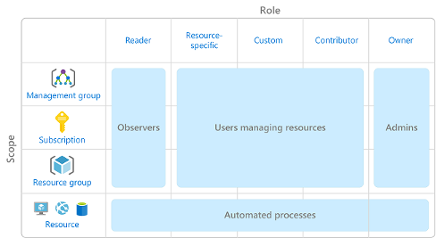
Azure role-based access control
Role-based access control is applied to a scope, which is a resource or set of resources that this access applies to.

Slide 22
Azure RBAC
Azure RBAC is enforced on any action that's initiated against an Azure resource that passes through Azure Resource Manager.
Azure RBAC doesn't enforce access permissions at the application or data level.
RBAC uses an allow model.

Slide 23
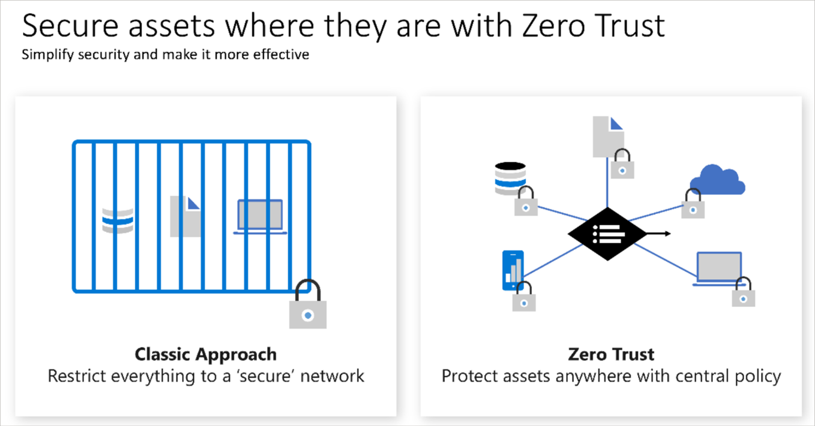
Zero Trust
Notes:
https://learn.microsoft.com/training/modules/describe-azure-identity-access-security/7-describe-zero-trust-model

Slide 24
Defense in depth
A layered approach to securing computer systems.
Provides multiple levels of protection.
Attacks against one layer are isolated from subsequent layers.
Physical security
Identity and access
Perimeter
Network
Compute
Application
Data
Notes:
https://learn.microsoft.com/training/modules/describe-azure-identity-access-security/8-describe-defense-depth
The objective of defense-in-depth is to protect information and prevent it from being stolen by those who aren't authorized to access it.
A defense-in-depth strategy uses a series of mechanisms to slow the advance of an attack that aims at acquiring unauthorized access to data.

Slide 25
Layers of defense
The physical security layer is the first line of defense to protect computing hardware in the datacenter.
The identity and access layer controls access to infrastructure and change control.
The perimeter layer uses distributed denial of service (DDoS) protection to filter large-scale attacks before they can cause a denial of service for users.
The network layer limits communication between resources through segmentation and access controls.
The compute layer secures access to virtual machines.
The application layer helps ensure that applications are secure and free of security vulnerabilities.
The data layer controls access to business and customer data that you need to protect.

Slide 26
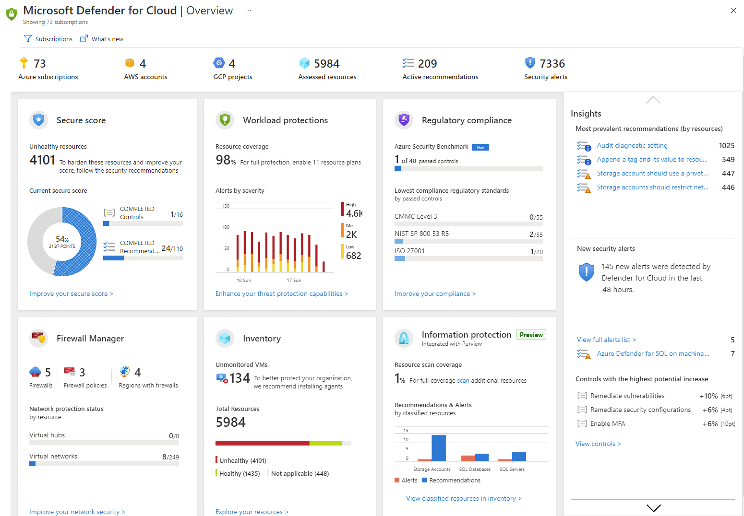
Microsoft Defender for Cloud
Microsoft Defender for Cloud is a monitoring service that provides threat protection across both Azure and on-premises datacenters.
Provides security recommendations.
Detect and block malware.
Analyze and identify potential attacks.
Just-in-time access control for ports.
Notes:
https://learn.microsoft.com/training/modules/describe-azure-identity-access-security/9-describe-microsoft-defender-for-cloud
Defender for Cloud is a monitoring tool for security posture management and threat protection. It monitors your cloud, on-premises, hybrid, and multi-cloud environments to provide guidance and notifications aimed at strengthening your security posture.
Defender for Cloud provides the tools needed to harden your resources, track your security posture, protect against cyber attacks, and streamline security management. Deployment of Defender for Cloud is easy, it’s already natively integrated to Azure.

Slide 27
Microsoft Defender
Defender for Cloud is a monitoring tool for security posture management and threat protection
Defender for Cloud provides the tools needed to harden your resources, track your security posture, protect against cyber attacks, and streamline security management.
Many Azure services are monitored and protected without needing any deployment
Log Analytics agent

Slide 28
Microsoft Defender
Defender for Cloud helps you detect threats across:
Azure PaaS services – Detect threats targeting Azure services, perform anomaly detection on your Azure activity logs
Azure data services - You can also get assessments for potential vulnerabilities across Azure SQL and Storage services
Networks - Defender for Cloud helps you limit exposure to brute force attacks
To extend protection to on-premises machines, deploy Azure Arc and enable Defender for Cloud's enhanced security features.

Slide 29
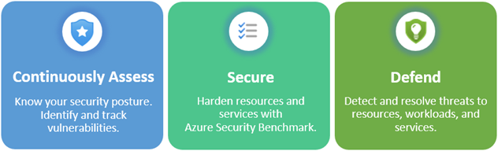
Microsoft Defender
Continuously assess – Know your security posture. Identify and track vulnerabilities.
Secure – Harden resources and services with Azure Security Benchmark.
Defend – Detect and resolve threats to resources, workloads, and services.

Slide 30
Microsoft Defender
Defender for Cloud also helps you defend your environment by providing security alerts and advanced threat protection features
Security alerts:
Describe details of the affected resources
Suggest remediation steps
Provide, in some cases, an option to trigger a logic app in response
Defender for cloud provides advanced threat protection features for many of your deployed resources, including virtual machines, SQL databases, containers, web applications, and your network -> securing the management ports of your VMs, adaptive application controls

Slide 31
Questions
Which Azure Active Directory tool can vary the credentials needed to log in based on signals, such as where the user is located?
Conditional Access
Guest access
Passwordless

Slide 32
Questions
2. Which security model assumes the worst-case security scenario, and protects resources accordingly?
Zero trust
Defense-in-depth
Role-based access control

Slide 33
Questions
3. A user is simultaneously assigned multiple roles that use role-based access control. What are their actual permissions? The role permissions are: Role 1 - read || Role 2 - write || Role 3 - read and write.
Read only
Write only
Read and write

Slide 34
Questions
4. Which layer of defense in depth is focused on preventing network-based attacks?
Select the correct option.
Data layer
Identity and access layer
Perimeter layer
Compute layer

